Slide 1


Smart Bank Management
An introduction to the implementation of C++ in smart bank management.
21BEC1085-VAMSHI S HARI HARA KIRAN REDDY J

Slide 2


Introduction to Smart Bank Management
Bank Building
Financial Technology
An image showcasing the exterior of a modern bank building.
An illustration displaying the integration of technology in the banking sector.

Slide 3
Motivation for Using C++ in Bank Management
1
Efficiency
2
Security
3
Scalability
Utilizing C++ can lead to faster and more efficient banking operations.
C++ offers robust security features, essential for protecting financial data.
The language's scalability makes it suitable for managing a wide range of bank operations.
Highlighting the importance of efficient banking operations
Addressing the need for accurate account management and transaction processing
Emphasizing the goal of enhancing customer satisfaction through streamlined banking processes

Slide 4
Literature Survey on C++ Applications in Finance
Overview of existing research and literature in bank management systems
Summary of relevant papers, articles, and resources studied
Insights gained from the literature survey regarding current practices and technologies
Research Papers
Case Studies
Exploration of academic research on C++ applications within the finance sector.
Analysis of real-world examples showcasing C++'s impact on financial systems.

Slide 5



Existing Issues in Bank Management and C++
Identification of common challenges in traditional banking systems
Examples of issues such as manual record-keeping, inefficient transaction processing, and security vulnerabilities
Impact of existing issues on customer experience and operational efficiency
Bugs
Security Breaches
Compatibility
Identification and resolution of bugs in C++ based bank management systems.
Challenges related to the security of C++ integrated bank management systems.
Issues related to compatibility of C++ with legacy bank management software.

Slide 6
Problem Description
Detailed description of the specific problems addressed by the Bank Management System project
Explanation of key challenges identified in traditional banking practices
Clear articulation of the project's objectives in resolving these challenges

Slide 7
Proposed Work
Overview of the proposed solution for addressing identified problems
Description of features, functionalities, and technologies planned for implementation
Highlights of how the proposed system aims to improve banking operations and customer service

Slide 8

Advantages of C++ for Smart Bank Management
1
Performance
Excellent performance and execution speed, crucial for real-time banking operations.
2
Control
Enhanced control over system resources and memory management capabilities.
3
Flexibility
Flexibility to create complex and feature-rich bank management software solutions.

Slide 9
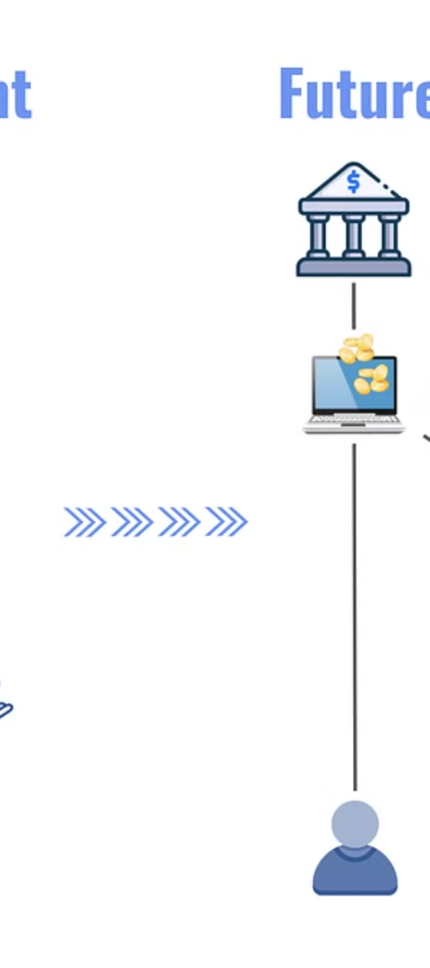



Implementation of C++ in Smart Bank Management
Planning
Thorough planning for the integration of C++ into smart bank management systems.
Development
Execution of the designed plan for implementing C++ in bank management.
Testing
Rigorous testing to ensure the seamless operation of C++ integrated solutions.

Slide 10

Case Studies and Examples
Bank XYZ
Software Solution A
An in-depth case study on the successful implementation of C++ in Bank XYZ's management system.
An example of a comprehensive software solution built using C++ for bank management.
Case Study B
An examination of the challenges and benefits of using C++ in Bank Management Case Study B.

Slide 11
Conclusion and Future Directions
Conclusion
Future Innovations
A recap of the advantages and challenges of employing C++ in smart bank management.
Exploration of innovative approaches for further enhancing C++ integrated bank systems.
As the banking industry continues to evolve, there are several future directions to explore in order to further enhance C++ integrated bank systems. This includes the incorporation of artificial intelligence and machine learning algorithms to improve fraud detection and risk assessment, as well as the utilization of blockchain technology for enhanced security and efficiency in financial transactions. Additionally, exploring ways to optimize the performance of C++ code in bank management systems could lead to faster processing times and better overall user experience.

Slide 12
THANK YOU

